Slide 1

Azure Machine Learning Studio:
Making Data Science Easy(er)
April 19th, 2018
Brad Llewellyn
Senior Analytics Associate – Data Science
Syntelli Solutions

Slide 2

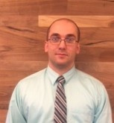



MCSE: Data Management and Analytics
MCSE: Cloud Platform and Infrastructure
MCSA: SQL Server 2012/2014
MCSA: Cloud Platform
MCSA: Machine Learning
M.S. Statistics: University of South Carolina
Analytics Consultant - >5 Years
Syntelli Solutions – 1 Month
@BreakingBI
https://www.linkedin.com/in/bradllewellyn
http://breaking-bi.blogspot.com
Llewellyn.wb@gmail.com
Charlotte BI Group Organizer - http://charbigroup.com
PASS Member and Speaker - https://www.pass.org
About Me
Brad Llewellyn
Senior Analytics Associate – Data Science
Syntelli Solutions

Slide 3
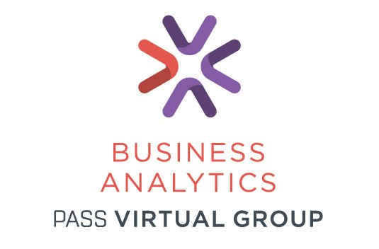
https://www.pass.org

Slide 4
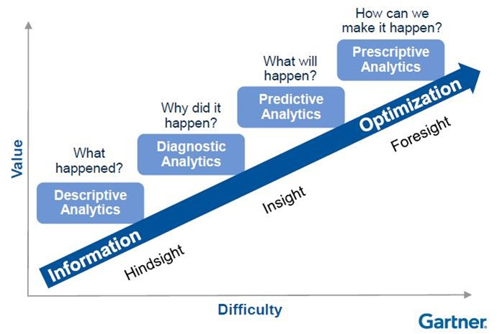
What is Data Science?
Data Science
Advanced Analytics

Slide 5



Agenda
What is Microsoft Azure?
Why Azure Machine Learning Studio?
Demo!!!

Slide 6
What is Microsoft Azure?

Slide 7

What is Microsoft Azure?
Cloud Infrastructure, Platform
and Computing
Enterprise Grade
Managed and Supported by Microsoft

Slide 8
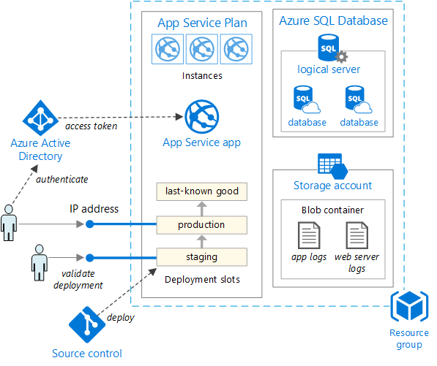
What Can We Build With Azure?
Virtual Machines
Virtual Networks
Databases
Storage
Applications
…

Slide 9
Why Azure Machine Learning?

Slide 10

Common Data Science Struggles
Steep Learning Curve and Code-Heavy Tools
Development, Testing and Optimization are Time-Consuming
Requires Heavy Knowledge of Statistical Techniques
Productionalization Can Be Time-Consuming and Expensive

Slide 11

What is Azure Machine Learning Studio?
Cloud Computing SaaS
Popular, Well-Documented Algorithms
Easily Accessible to Data Professionals
Code-Free GUI
(if you want it to be)
Easily Integrates into Enterprise Data Structure

Slide 12
DEMO!!!

Slide 13
What are you waiting for?
Step 1: Create a Free Workspace
Step 2: Find Quick Solutions to Your Organizations Problems
Step 3: Become the Boss!
Step 4: Tell your friends!

Slide 14

Other Presentations
Four Paths to Data Science Success using Microsoft Azure
Azure Machine Learning Studio: Four Tips from the Pros
What is a Data Scientist and How Do I Become One?
Thank You!
Brad Llewellyn
Senior Analytics Associate – Data Science
Syntelli Solutions
@BreakingBI
https://www.linkedin.com/in/bradllewellyn
http://breaking-bi.blogspot.com
Llewellyn.wb@gmail.com

